Slide 1


Background
Adaptive Markets
Steve Kunath, Kevin McCabe, Alex Psurek, Sarah Sylvester,
George Mason University
kmccabe@gmu.edu

Slide 2
The Exchange Process
Institutions act on the environment to produce outcomes
Connections
Promises
&
Contracts
The Environment
Production
&
Property Transfers
Goodwill &
Side Payments &
Judgments
Resources
- What
Technologies
- How
People
- Who
Matching
Negotiation
Fulfillment
Resolution
Continue Relationship ?

Slide 3
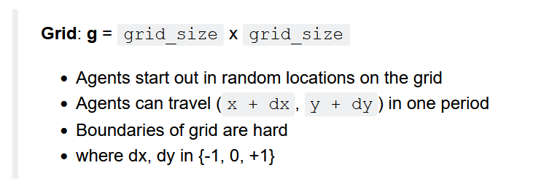
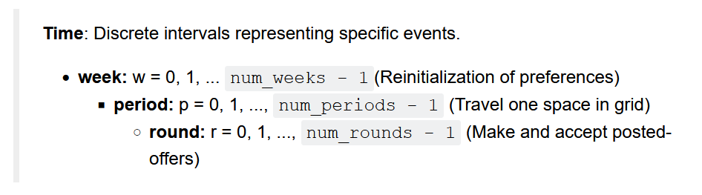
Our Model (Environment)
Gode and Sunder ZI – BC; Axtell and Epstein – Sugarscape

Slide 4
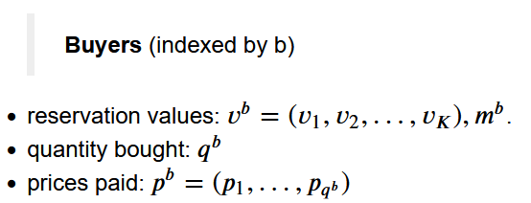

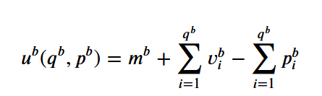

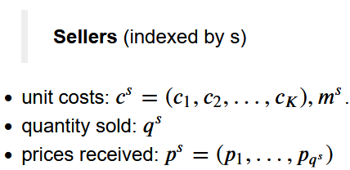



Our Model (Agents)

Slide 5
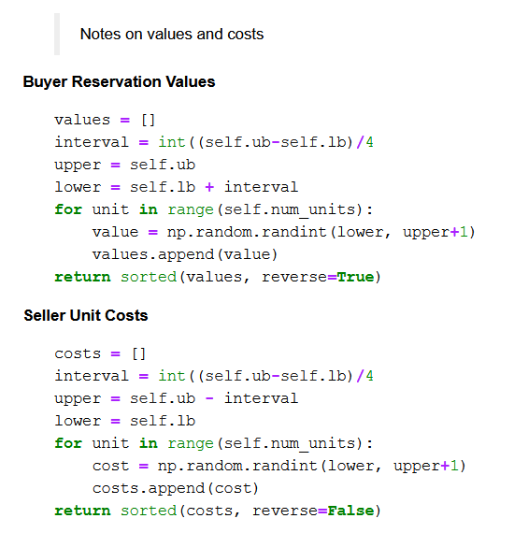

Slide 6
Our Model (Institutions in Blue)
Trial Loop: trial
agent_list = make_agents(…)
set random location for all agents
Week Loop: week
set cur_unit = 0 for all agents.
Period Loop: period
Travel Institution -> grid
for agent in agent_list:
`request_move` -> ‘move’ (dx, dy)
Grid Loop: grid_point
If buyer and seller at grid point:
Round Loop: round
Bargain Institution -> contracts
for agent in agent_list:
`request_offer` -> bid or ask; makes order_book
For agent in shuffled(agent_list):
‘request_decision’ -> buy or sell; makes contract

Slide 7
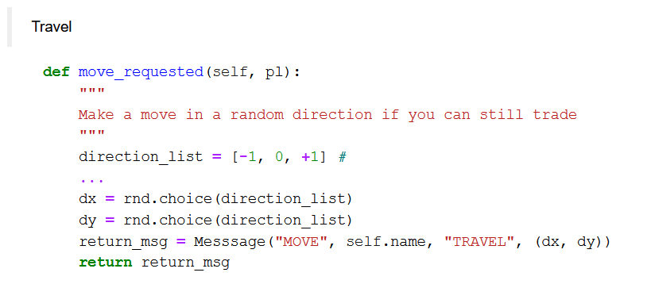
ZID Budget Constrained Strategy

Slide 8
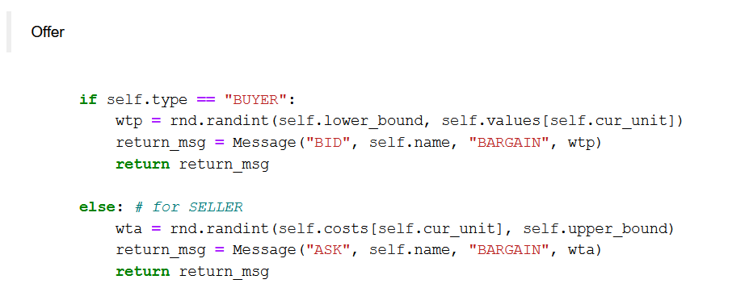
ZID Budget Constrained Strategy (continued)

Slide 9
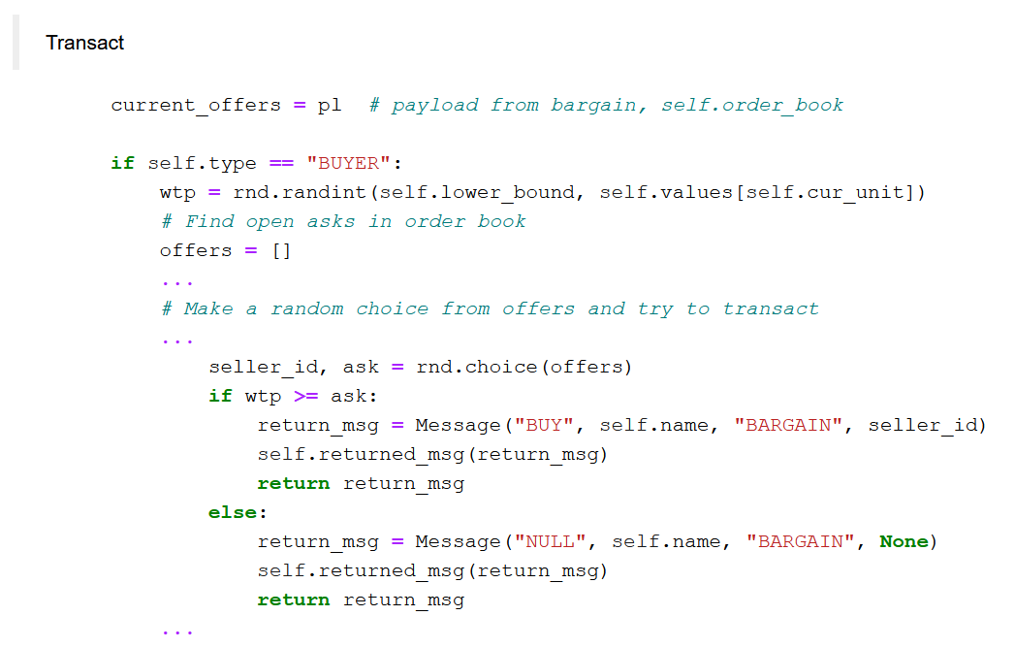
ZID Budget Constrained Strategy (continued)

Slide 10
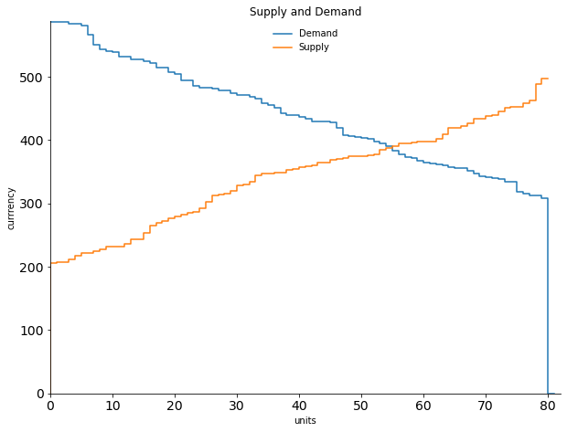
One Period ZID Simulation
equilibrium price = 388 - 391
equilibrium quantity = 55
maximum surplus = 9887
Example Period Simulation
grid_size = 1
num_rounds = 10
num_traders = 20
num_units = 8
lower_bound = 200
upper_bound = 600

Slide 11
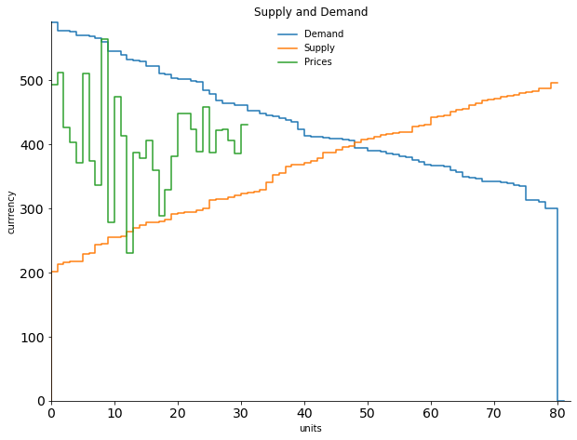
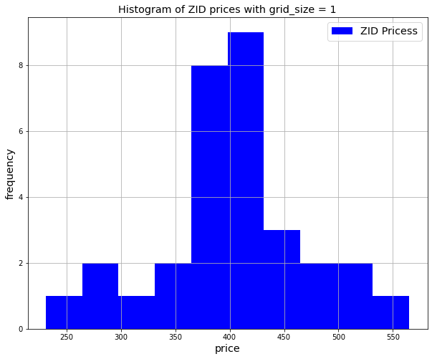
equilibrium price range is 398 to 403
average price = 404.84
eq expected contracts = 48, actual contracts = 31 actual surplus = 7283 , maximum surplus = 8890
efficiency = 81.92%.
One Period ZID Simulation Results

Slide 12
Multi Trial Simulations

Slide 13
Comparing Agent Strategies
ZID(TRADER):
MOVE -> (dx, dy) where dx ~ {-1, 0, +1}, and dy ~ {-1, 0, +1}
BID, ASK -> uniform random budget constrained offer
BUY, SELL -> uniform random budget constrained willingness to accept
-> uniform random choice of offer
ZIDA(ZID):
MOVE -> if contract at period -> don’t move again; (dx, dy) = (0, 0)
-> otherwise, (dx, dy) where dx ~ {-1, 0, +1}, and dy ~ {-1, 0, +1}

Slide 14
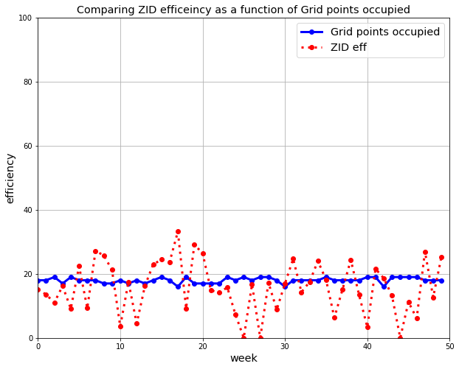
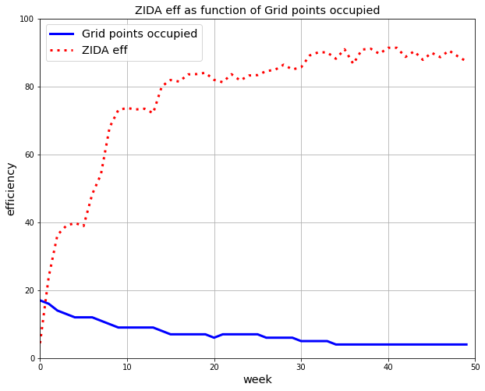
ZID and ZIDA strategies vs Number of grid points occupied
num_periods = 7
num_weeks = 50
num_rounds = 5
grid_size = 15
num_traders = 20
num_units = 8
lower_bound = 200
upper_bound = 600
Note local max
Number of agents at grid points occupied = [3, 6, 7, 4]

Slide 15
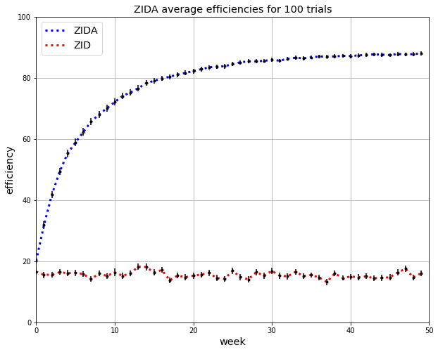
Compare efficiency of ZID, ZIDA
num_trials = 100
num_periods = 7
num_weeks = 50
num_rounds = 5
grid_size = 15
num_traders = 20
num_units = 8
lower_bound = 200
upper_bound = 600

Slide 16
Comparing Agent Strategies
ZID(TRADER):
MOVE -> (dx, dy) where dx ~ {-1, 0, +1}, and dy ~ {-1, 0, +1}
BID, ASK -> uniform random budget constrained offer
BUY, SELL -> uniform random budget constrained willingness to accept
-> uniform random choice of offer
ZIDP(ZID):
BUY, SELL -> uniform random budget constrained willingness to accept
-> picks best remaining offer

Slide 17
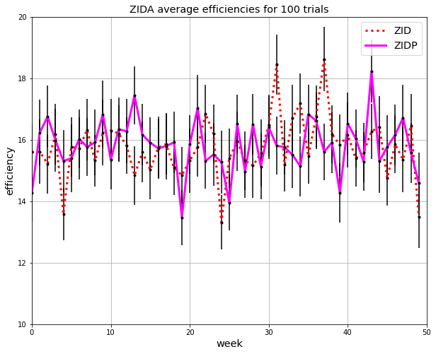
Compare efficiency of ZID, ZIDP
Note Narrow range on y-axis of graph
num_trials = 100
num_periods = 7
num_weeks = 50
num_rounds = 5
num_traders = 20
num_units = 8
lower_bound = 200
upper_bound = 600
grid_size = 15

Slide 18
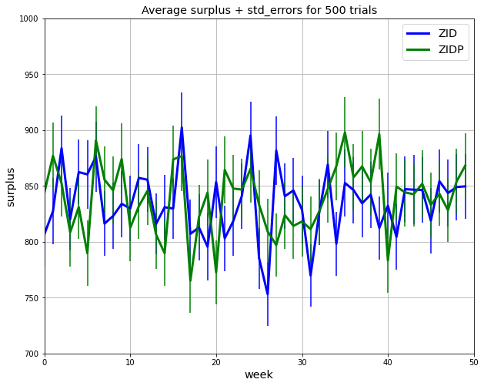
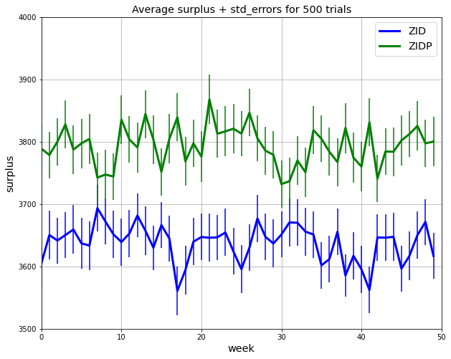
Compare surplus generation of ZID, ZIDP
Note: Change in range of y axis
num_trials = 500
num_periods = 7
num_weeks = 50
num_rounds = 5
num_traders = 20
num_units = 8
lower_bound = 200
upper_bound = 600
grid_size = 15
grid_size = 5

Slide 19
Comparing Agent Strategies
ZID(TRADER):
MOVE -> (dx, dy) where dx ~ {-1, 0, +1}, and dy ~ {-1, 0, +1}
BID, ASK -> uniform random budget constrained offer
BUY, SELL -> uniform random budget constrained willingness to accept
-> uniform random choice of offer
ZIDP(ZID):
BUY, SELL -> uniform random budget constrained willingness to accept
-> picks best remaining offer
ZIDA(ZID):
MOVE -> if contract at point -> don’t move (dx, dy) = (0, 0)
-> otherwise, (dx, dy) where dx ~ {-1, 0, +1}, and dy ~ {-1, 0, +1}
ZIDPA(ZIDP, ZIDA)

Slide 20
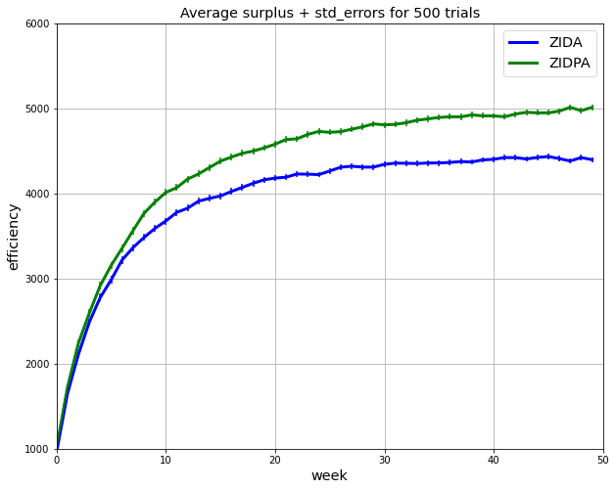
Compare Surplus 50% ZIDA, and 50% ZIDPA
num_trials = 500
num_periods = 7
num_weeks = 50
num_rounds = 5
grid_size = 15
num_traders = 20
num_units = 8
lower_bound = 200
upper_bound = 600

Slide 21
Comparing Agent Strategies
ZIDP(ZID):
BUY, SELL -> uniform random budget constrained willingness to accept
-> picks best remaining offer
ZIDPR(ZIDP):
MOVE
-> if num_agents at point > 2:
(dx, dy) where dx ~ {-1, +1} and dy ~ {-1, +1}
-> else:
if contract last period:
(dx, dy) = (0, 0):
else:
(dx, dy) where dx ~ {-1, 0, +1}, and dy ~ {-1, 0, +1}

Slide 22
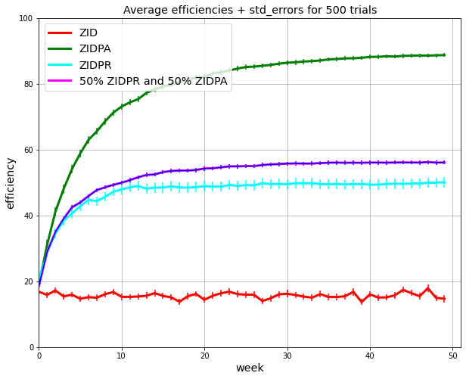
Compare Efficiency at 50% ZIDPA, and 50% ZIDPR
num_trials = 500
num_periods = 7
num_weeks = 50
num_rounds = 5
grid_size = 15
num_traders = 20
num_units = 8
lower_bound = 200
upper_bound = 600

Slide 23
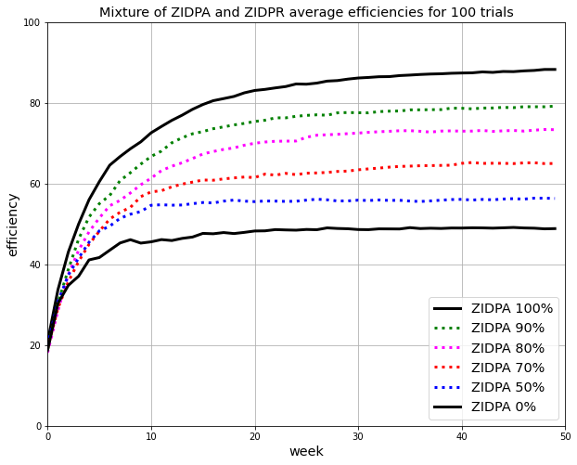
ZIDA 100%
ZIDA 90%
ZIDA 80%
ZIDA 70%
Compare Efficiency at %ZIDA, and %ZIDPR
ZIDA 50%
ZIDA 0%
num_trials = 100
num_periods = 7
num_weeks = 50
num_rounds = 5
grid_size = 15
num_traders = 20
num_units = 8
lower_bound = 200
upper_bound = 600

Slide 24
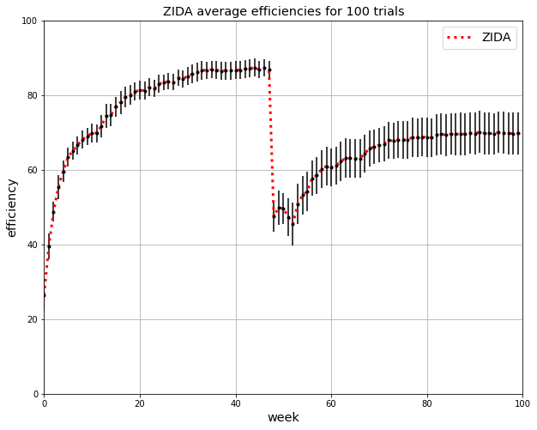
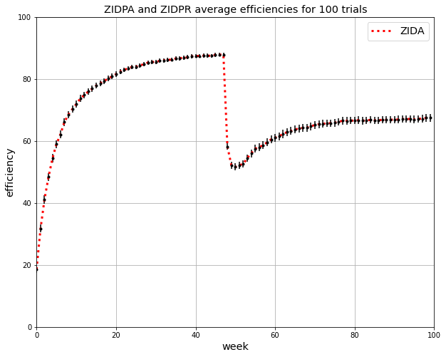
Injecting ZIDPR at week 48 until week 52
Compare surplus generation of ZID, ZIDP
Note Narrow range on y-axis of graph
num_trials = 100
begin event = 48
end event = 52
num_periods = 7
num_weeks = 50
num_rounds = 5
num_traders = 20
num_units = 8
lower_bound = 200
upper_bound = 600
100% ZIDPR during event
30% ZIDPR during event

Slide 25
Thank You

Slide 26
Results
MES – On a spatial grid with order-book bargaining (First Two Stages)
ZID – Random Mover: Does not do well on spatial grid.
ZIDA – Stays when it contracts: Does much better than ZID spatial grid.
ZIDP – Takes best offer in order-book: Better (eff, rent-seeking) than ZID in small grids
ZIDPA – Combines ZIDA and ZIDP: Not more efficient than ZIDA, but better rent seeker
ZIDR – Avoids crowds > 2; does much worse (eff, rent-seeking) than ZIDA
ZIDPR – ZIDR & ZIDP – Same Results for eff and rent-seeking
- Pulls down eff disproportionately when combined with ZIDPR

